Slide 1



controlSBML: A Python Package for
Control Engineering With SBML Models
Harmony 2022
Joseph L. Hellerstein
eScience Institute
University of Washington, USA
April 26, 2022

Slide 2
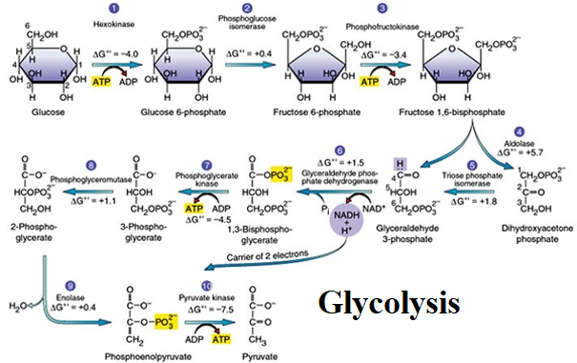
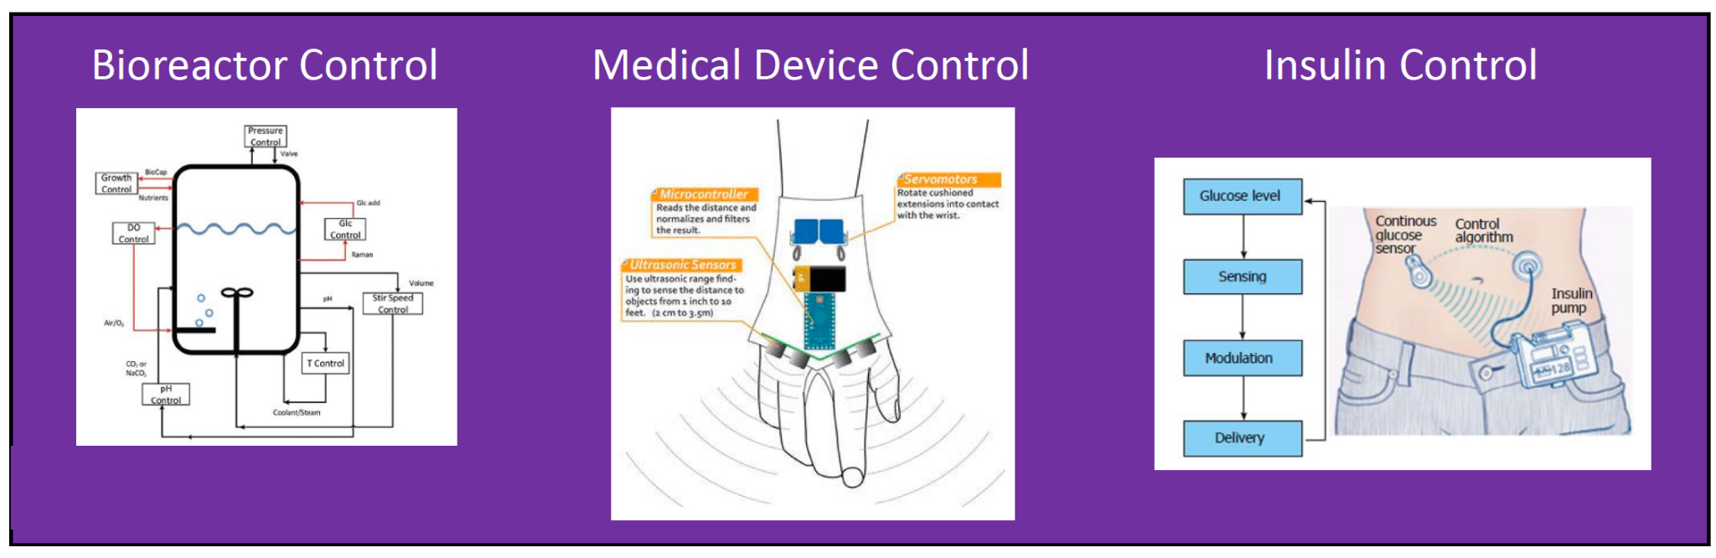
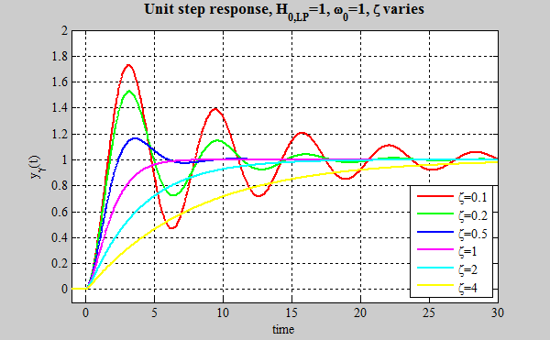
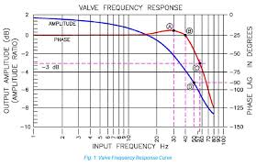
Control Engineering of Biological Systems
Control Engineering
Controllability: Find actuators that affect the desired outputs.
Observability: Estimate unobservable states.
Design: Design feedback control that converges quickly to a desired value.
Evaluation: Does the feedback control achieve its objectives and is it robust to noise and disturbances?
Tools Provide Analyses
step
response
frequency
response
Notes:
Insert pictures from tools for each of these tasks

Slide 3
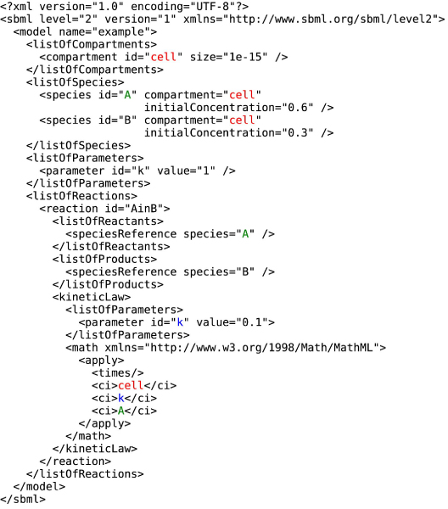
Control Analysis of SBML Models
CalTech control package
controlSBML
NonlinearIOSystem
TransferFunction
StateSpace
input_output_response
step_response
impulse_response
bode
Interconnect
place
Objects Analyzed
makeNonlinearIOSystem
makeTransferFunction
makeStateSpace
SBML Model
https://github.com/ModelEngineering/controlSBML
pip install controlSBML
Notes:
show what package requires for analysis and objects created by controlSBML
pip install

Slide 4
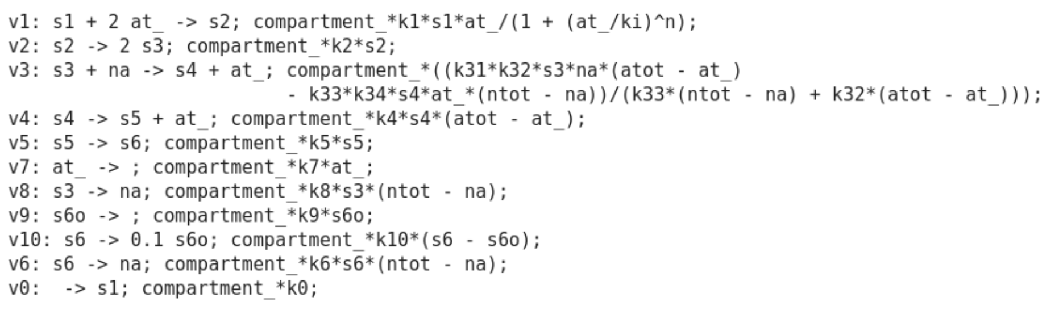
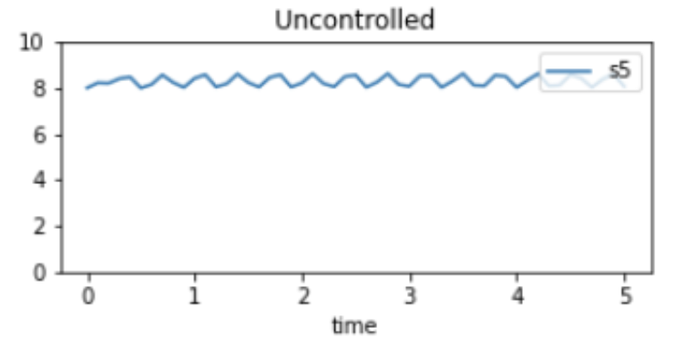
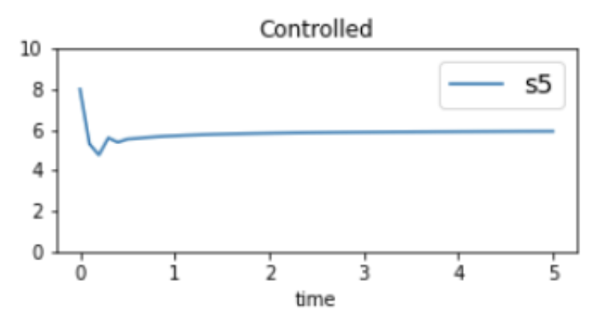
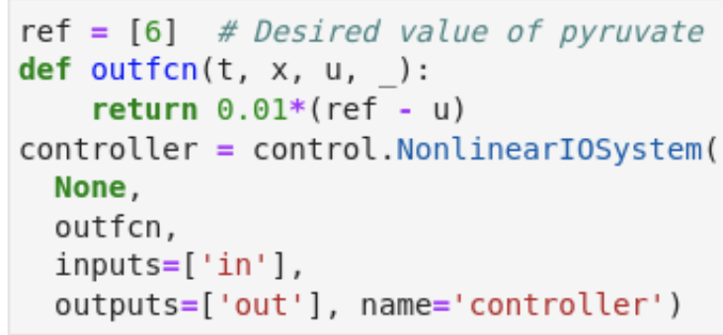
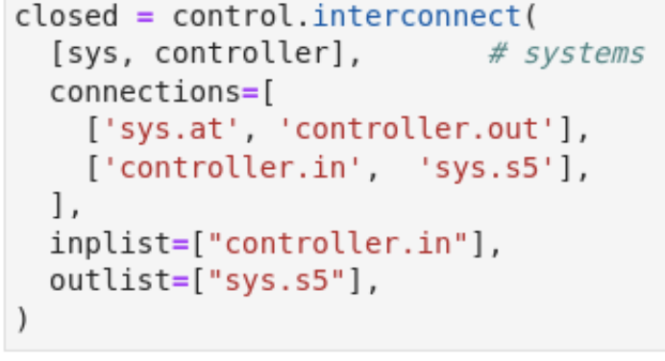
Glycolytic Oscillations (BioModels 206)
Control Engineering
Controllability
Observability
Design
Evaluation
ATP
pyruvate
at
(ATP)
6
Control objectives
Remove oscillations
s5 converges to 6
Controller
Glycolysis
s5
(pyruvate)
-
Success!

